Slide 1
WelCome
Notes:
# Speaker notes

Slide 2
Team-5
Money and Monitory
Problem statement:
Design a system which credits extra spent by customers back into their accounts, as rounded off figure. Customers who make a debit card transaction have that transaction rounded up to the nearest pound and that ‘extra’ credited to an instant access savings account. The ability to have round ups will be controlled in the app which will drive digital adoption using any device, while encouraging customers to get into the savings habit.
Team members:
Ajey Kalagi
Reema Gera
Suryanshu Gautam
Vinay Kumar Nallamothu

Slide 3
Pain Points
Limited saving opportunities
Customers may find it challenging to set aside small amounts for savings. Without the automatic round-up feature, they might need to manually transfer funds, which can be cumbersome and may result in savings being neglected.
Lack of awareness
Some customers may not be aware of the benefits of saving spare change. They might not realize the potential for accumulating a significant amount over time.
Missed savings opportunities
Customers might forget to round up certain transactions, missing out on potential savings. This can lead to a loss of financial benefits over time.

Slide 4
Solution - Spend2Save
Automated savings
The round-up feature automates the process of saving spare change, making it effortless for customers. This encourages a consistent savings habit.
Increased awareness
By displaying the round-up amounts and showing customers how their spare change adds up, the feature raises awareness about the benefits of saving.
Improved financial health
The automated savings contribute to improved financial health, helping customers build a safety net or work towards specific financial goals.

Slide 5
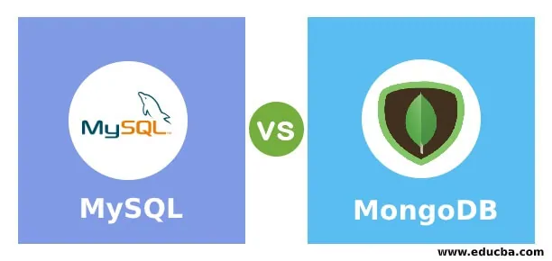
Architecture Diagram
Eureka server
Auth service
Accounts
service
React JS
Apache Tomcat
API gateway
Transactions service

Slide 6
Data Flow
Sign Up
Login
Landing page
Home Page
Make Transaction
View Balance
View Transaction history
Redeem savings
Enable/Disable
Auth
service
Transactions service
Accounts service
Apache Tomcat

Slide 7

Application Demo

Slide 8
MicroServices Pattern
Microservices used for each component:
Signup
Accounts service- for verifying the customer signing up is currently a natwest bank account holder.
Signup service - posting the customer data signed up into database.
Transactions service - posting the customer id to create a collection enabling the customer to perform transactions.
Sign In
Signup service- Verifying the customer signing in valid or not.
Make Transaction
Accounts service- Verifying the entered netbanking username, password and debit card details valid or not.
Transactions service- Posting the transaction performed into database.
View balance
Accounts service- fetching balance of main account
Transactions service- fetching balance of instant savings account

Slide 9
MicroServices Pattern
Microservices used for each component:
Redeem savings
Account service- Verifying the pin entered valid or not.
Transactions service- Posting the redemption performed into database.
Enable/Disable feature
Account service- Verifying the entered customerID and pin valid or not.
Transactions service- Getting the status of feature and changing the status of feature.
Transaction history
Transactions service- Fetch transactions done by customer using customer ID

Slide 10
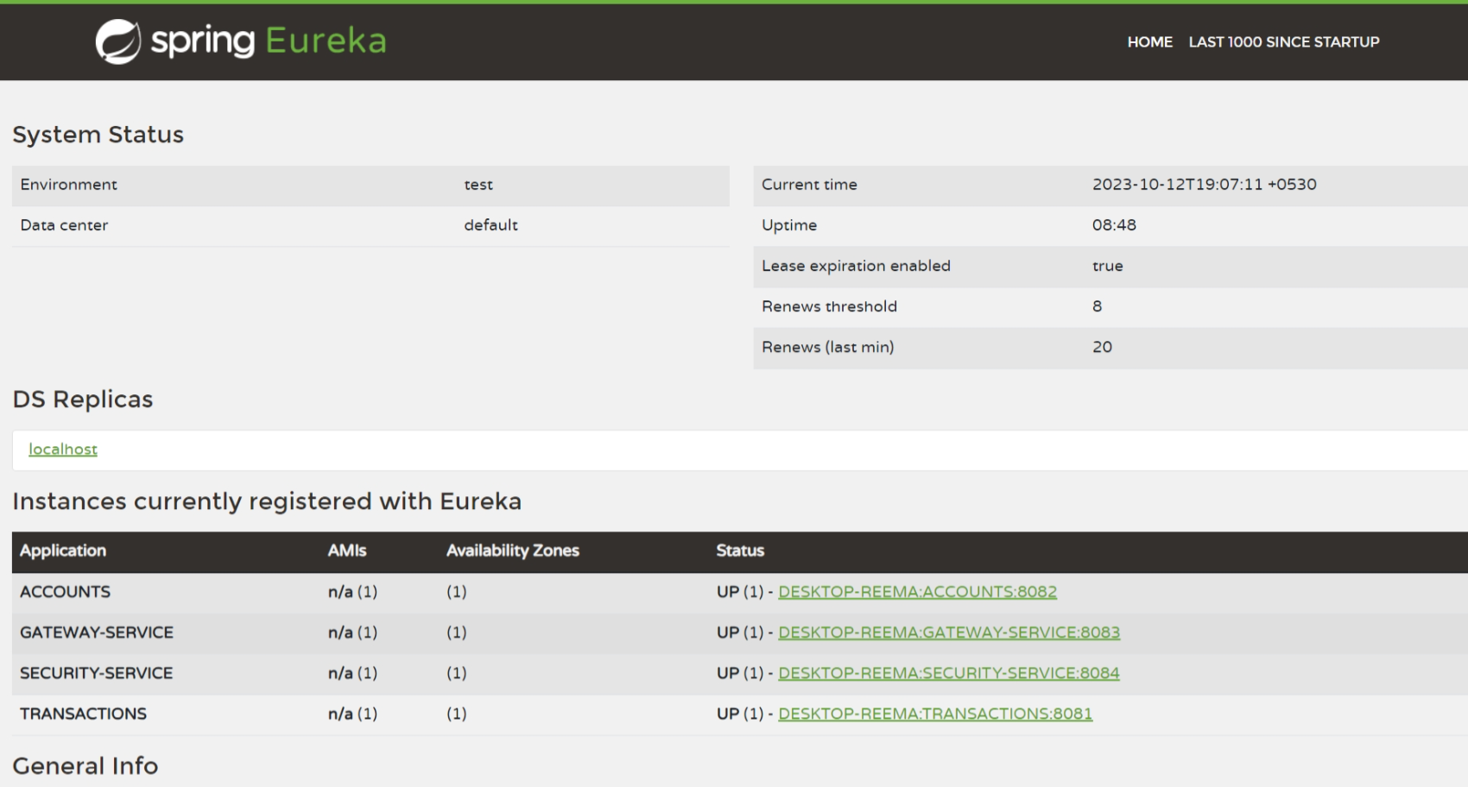
Eureka Server

Slide 11
API Gateway
Port: 8083
API gateway
Accounts
service
SignUp
service
Transactions service
Port: 8082
Port: 8084
Port: 8081
Apache Tomcat

Slide 12
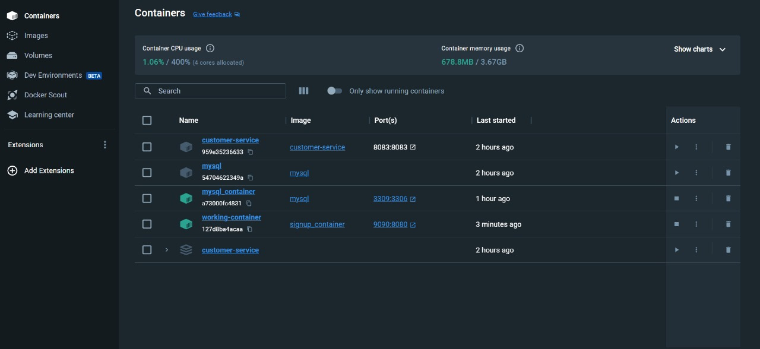
Dockerization

Slide 13
Tech Stack
Technologies used are:
React JS
Spring boot
MongoDB
MySQL

Slide 14
Product Backlog & Revenue

Slide 15
Product Backlog
Extensive testing should be done to make the product robust.
Need to add feature for editing the customer details like, forgot password, profile management.

Slide 16
Revenue
Advertising
Can prove to be a great feature for customer acquisition.
Referral programs
Savings Interest
White-Label Solution

Slide 17
Thank You

